Slide 1
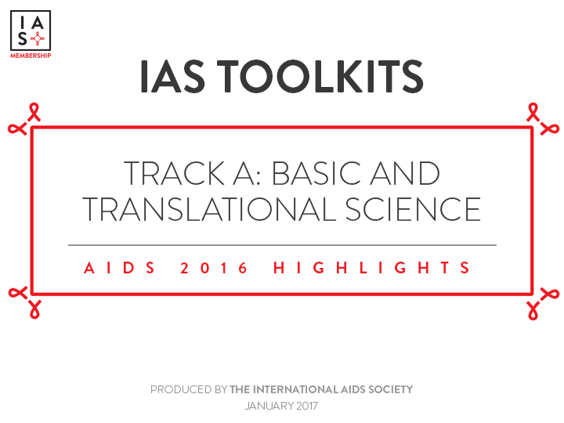
IAS Toolkits
Track A: Basic and Translational Science
AIDS 2016 Highlights
Produced by the International AIDS Society
January 2017

Slide 2
Contents
Overview…………………………………………………………………………………………………3-4
Progress on Vaccines……..……………………………………………………………………..5-10
Latent HIV Reservoir and Opportunities for Cure………………………………..11-19
Basic Implications for Treating Early….…………………………..……………………20-22
Vaginal Microbiome and HIV Acquisition…………………………………………….23-27
Other Correlates of HIV Acquisition………………………………………………….…28-32
Basic and Translational Science Highlights.….…………………………………………..33
Concluding Thoughts…………………………………………………………………………….…34

Slide 3
Overview
Progress on Vaccines
HVTN 100
AMP Studies
Janssen Programme
New Vaccine Concepts
Latent HIV Reservoir & Opportunities for Cure
Mississippi Baby Case
Measuring the HIV Reservoir
SEARCH 019
Allogenic Stem Cell Transplant
New Concepts
Basic Implications of Treating Early
No Replication During ART?
FRESH Cohort
Unspliced RNA as Biomarker
Vaginal Microbiome and HIV Acquisition
Prevotella Bivia
Lactobacillus & PrEP
Implications
Other Correlates of HIV Acquisition
HPV
Injectable Contraceptives
Th17
Notes:
Track A notably addressed:
Basic science related to pre-infection / prevention: HIV vaccine pipeline and correlates of vaccine protection + correlates of HIV acquisition
Basic science related to post-infection: latent HIV reservoir and opportunities for cure + acute HIV infection

Slide 4
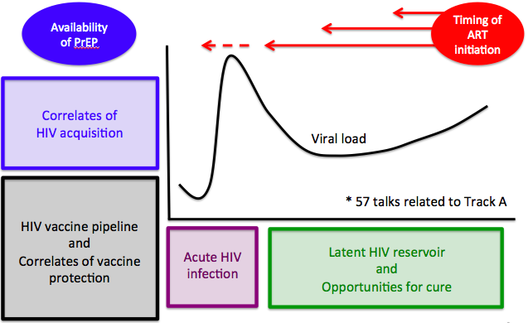
Overview
time
FRPL0201

Slide 5
Progress on Vaccines
Introduction
Many prevention strategies (TasP, PrEP, condoms etc) require continuous adherence and community saturation
  Therefore getting to an AIDS free generation will require a vaccine
“The HIV vaccine field is open for business”: three pivotal HIV vaccine related efficacy trials are in progress or soon to be initiated
These pivotal efficacy studies will define if either or both neutralizing and/or non-neutralizing antibodies can be tweaked to provide reasonable vaccine efficacy in high risk Clade C regions of the world
These studies will set the stage for the entire design and development of HIV vaccines for the next decade
Efficacy Studies
P5 “Clade C” approach using ALVAC & gp120/MF59
(HVTN 702)
Multi-clade approach using rAd26/MVA/gp140 trimer
(Crucell/Janssen)
Neutralizing antibody approach using VRC01
(AMP Trial: HVTN 703/HPTN 083, HVTN 704/HPTN 085)
Corey WEPL0104

Slide 6
Progress on Vaccines
HVTN 100
HVTN100 = double-blind phase I/II RCT of an investigational HIV-1 vaccine in 252 HIV-uninfected South African adults
Vaccine design modeled after the RV144 study (ALVAC priming injections with 2 recombinant clade B/E gp120 boosters) in Thailand
Vaccine adapted to include clade C specific components: ALVAC clade C plus bivalent gp120 C booster
Construct Bivalent Subtype C gp120/MF59
Construct ALVAC-HIV-C
(vCP2438)
Add Booster at
12 months
Optimize regimen for regional relevance, increased potency, and durability
Bekker TUAX0102LB
Notes:
BEKKER
Background: The RV144 ALVAC-HIV/AIDSVAX® B/E/alum HIV vaccine trial conducted in Thailand demonstrated 31% vaccine efficacy at 3.5 years. Following RV144, vaccine components were modified to express HIV-1 antigens matched to circulating clade C strains, the adjuvant was changed to MF59 and a booster immunization was added. The vaccine regimen of clade C ALVAC-HIV (strains ZM96 and LAI), and bivalent subtype C gp120 (strains 1086.C and TV-1) /MF59 is being tested in a phase1/2 trial, HVTN100 in 6 South African clinical trial sites. Archived RV144 samples were contemporaneously compared to vaccine-induced immune responses in HVTN100 samples. Four pre-specified immune criteria associated with vaccine take; potency and correlates of risk in RV144 guided the decision about whether or not to proceed to a phase 2b efficacy trial.
Methods: 52 HIV-uninfected adults (43% female) were enrolled and randomly assigned to receive vaccine (n= 210) or placebo (n=42). Humoral and cellular responses were measured 2 weeks after the 6-month vaccination (ALVAC-HIV/Bivalent Subtype C gp120/MF59 boost) in HVTN100 (185 vaccine/ 37 placebo) and contemporaneously assayed RV144 (201 vaccine/ 24 placebo) samples from per-protocol participants. Twelve-month booster vaccinations are currently ongoing.
Results: No safety concerns were identified. 100% of HVTN100 vaccine-recipients developed IgG binding antibodies to all three clade C gp120 vaccine-matched envelope insert antigens with significantly higher titers (3.6-8.8 fold, P''s < 0.001) than in RV144 to the corresponding RV144 vaccine-matched antigens. CD4 T cell response rate to the ALVAC ZM96 envelope antigen in HVTN100 was 57.5% vs. 41.4% to 92TH023 in RV144 (P=0.002), with a significantly greater 5-function polyfunctionality score in HVTN100 (P < 0. 001). 80% (95%CI=74.0%-85.4%) of participants in HVTN100 demonstrated an IgG response to at least one of the three vaccine-matched V1V2 antigens, above the 63% threshold needed to predict 50% vaccine efficacy in a Phase 2b trial under a V1V2 correlate of protection model.
Conclusions: Cellular and humoral immune responses in HVTN100 met pre-specified criteria, supporting future evaluation in a phase 2b vaccine efficacy trial. This will also be critical for defining relevant correlates of protection of this regimen in Southern African.

Slide 7
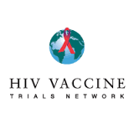
Progress on Vaccines
HVTN 100
Cellular and humoral immune responses evaluated based on 4 criteria
These were associated with vaccine take, potency and correlates of risk in RV144
HVTN100 met and sometimes exceeded all 4 of the predefined criteria and the immune responses seen in RV144
All participants developed IgG binding antibodies to all three clade C gp120 vaccine-matched envelope insert antigens.
80% of participants demonstrated an IgG response to at least one of the three vaccine-matched V1V2 antigens.
The level of immune responses to these key immunogenicity markers support the decision to move forward with pivotal efficacy trial HVTN 702
HVTN 702 = double blind Phase III RCT of 5,400 adults, beginning November 2016, running over four years
Bekker TUAX0102LB
Notes:
BEKKER
Background: The RV144 ALVAC-HIV/AIDSVAX® B/E/alum HIV vaccine trial conducted in Thailand demonstrated 31% vaccine efficacy at 3.5 years. Following RV144, vaccine components were modified to express HIV-1 antigens matched to circulating clade C strains, the adjuvant was changed to MF59 and a booster immunization was added. The vaccine regimen of clade C ALVAC-HIV (strains ZM96 and LAI), and bivalent subtype C gp120 (strains 1086.C and TV-1) /MF59 is being tested in a phase1/2 trial, HVTN100 in 6 South African clinical trial sites. Archived RV144 samples were contemporaneously compared to vaccine-induced immune responses in HVTN100 samples. Four pre-specified immune criteria associated with vaccine take; potency and correlates of risk in RV144 guided the decision about whether or not to proceed to a phase 2b efficacy trial.
Methods: 52 HIV-uninfected adults (43% female) were enrolled and randomly assigned to receive vaccine (n= 210) or placebo (n=42). Humoral and cellular responses were measured 2 weeks after the 6-month vaccination (ALVAC-HIV/Bivalent Subtype C gp120/MF59 boost) in HVTN100 (185 vaccine/ 37 placebo) and contemporaneously assayed RV144 (201 vaccine/ 24 placebo) samples from per-protocol participants. Twelve-month booster vaccinations are currently ongoing.
Results: No safety concerns were identified. 100% of HVTN100 vaccine-recipients developed IgG binding antibodies to all three clade C gp120 vaccine-matched envelope insert antigens with significantly higher titers (3.6-8.8 fold, P''s < 0.001) than in RV144 to the corresponding RV144 vaccine-matched antigens. CD4 T cell response rate to the ALVAC ZM96 envelope antigen in HVTN100 was 57.5% vs. 41.4% to 92TH023 in RV144 (P=0.002), with a significantly greater 5-function polyfunctionality score in HVTN100 (P < 0. 001). 80% (95%CI=74.0%-85.4%) of participants in HVTN100 demonstrated an IgG response to at least one of the three vaccine-matched V1V2 antigens, above the 63% threshold needed to predict 50% vaccine efficacy in a Phase 2b trial under a V1V2 correlate of protection model.
Conclusions: Cellular and humoral immune responses in HVTN100 met pre-specified criteria, supporting future evaluation in a phase 2b vaccine efficacy trial. This will also be critical for defining relevant correlates of protection of this regimen in Southern African.

Slide 8


Progress on Vaccines
The Antibody Mediated Prevention (AMP) Studies
VRC01: Broadly neutralising antibody prevented infection in animal models
  Safe and well tolerated during three Phase I trials with 140 human participants
Can a passively infused monoclonal antibody prevent HIV-1 infection in high risk adults?
Two placebo controlled trials opened earlier in 2016
Powered to detect 60% efficacy; and to associate VRC01 plasma level with protection
Variation in the doses may define the optimal concentrations of neutralizing activity associated with protection from acquisition in two cohorts with different routes of acquisition/genital tract immunology
HVTN 704/HPTN 085
HVTN 703/HPTN 081
2,700 MSM & TG
1,500 Women
Mgodi TUSY0305
Corey WEPL0104
Notes:
The AMP (antibody-mediated prevention) Studies are two multinational Phase 2b clinical trials of an intravenously delivered investigational antibody for preventing HIV infection. The trials will test whether giving people an investigational anti-HIV antibody called VRC01 as an intravenous infusion every 8 weeks is safe, tolerable and effective at preventing HIV infection. The trials also are designed to answer fundamental questions for the fields of HIV prevention and vaccine research.
Laboratory studies have shown that the VRC01 antibody stops up to 90 percent of a globally representative sample of nearly 200 HIV strains from infecting human cells. For this reason, it is considered to be a broadly neutralizing antibody. It was first discovered in the blood of an HIV-infected person whose body was able to control the infection without antiretroviral drugs for many years before needing treatment.
Many scientists believe that if a vaccine were developed that elicited broadly neutralizing HIV antibodies in healthy people, it would protect them from HIV infection. The AMP Studies will test this hypothesis by directly giving people the VRC01 antibody. In addition, the studies could clarify what level of broadly neutralizing antibodies a vaccine or other long-acting HIV prevention method needs to achieve and maintain to provide sustained protection from the virus.
HVTN 703/HPTN 081 will be conducted at 15 sites in Botswana, Kenya, Malawi, Mozambique, South Africa, Tanzania and Zimbabwe. HVTN 704/HPTN 085 will be conducted at 24 sites in Brazil, Peru and the United States.
Both studies are Phase 2b trials. Volunteers will be assigned at random to receive an intravenous infusion of either the VRC01 antibody at a dose of 30 milligrams per kilogram (mg/kg), VRC01 at a dose of 10 mg/kg, or a saline solution (a placebo). Neither the volunteers nor the study investigators will know who receives which type of infusion until the end of the study. Volunteers will receive a total of 10 infusions, once every 8 weeks, and then will be followed for 20 more weeks.
Volunteers will be tested for HIV infection once every 4 weeks and at any time after reporting possible exposure to the virus. Those who test positive for HIV will stop receiving infusions but will remain in the study for follow-up and be referred to professionals in their communities for appropriate medical care.

Slide 9
Progress on Vaccines
Janssen Prophylactic Vaccine Development Programme
Ambitious research programme to develop a prime-boost vaccine that would act against a wide variety of HIV subtypes
Two or more prime doses of a ‘mosaic antigen’ made up of gene sequences from a wide variety of different HIV viruses in a viral shell, followed by two boost doses of HIV envelope protein
APPROACH study:
  Ad26.Mos.HIV and heterologous regimens
  All 400 participants received their 3rdvaccination at 6 months
  Follow up is to twelve months
TRAVERSE study:
  Ad26.Mos4.HIV (4-valent) compared to Ad26.Mos.HIV (3-valent)
  First of 198 participants recruited
ASCENT study:
  Ad26.Mos4.HIV and Mosaic gp140+Clade C gp140 compared to Ad26.Mos4.HIV and Clade C gp140 alone
  Opens quarter 4 2016
  150 participants
Schuitemaker TUSY0306
Notes:
Each one of the 3 studies presented on this slide are Phase 1/2a

Slide 10
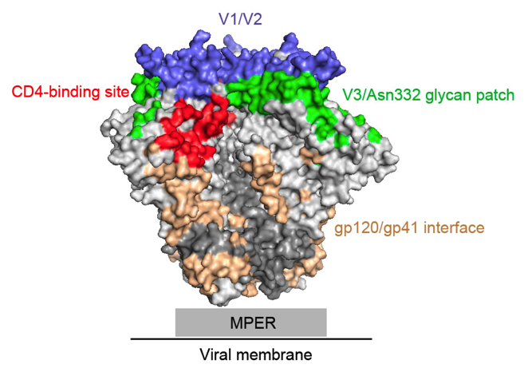
Progress on Vaccines
New Vaccine Concepts
Immunogens to induce broadly neutralising antibodies
Replicating vectors
Novel insert designs - to optimize breadth & durability
“We’re trying to mess with the immune system in a way old vaccinologists never thought of.”
  Nicole Frahm, Fred Hutchinson Cancer Research Center
Frahm TUSY0307

Slide 11
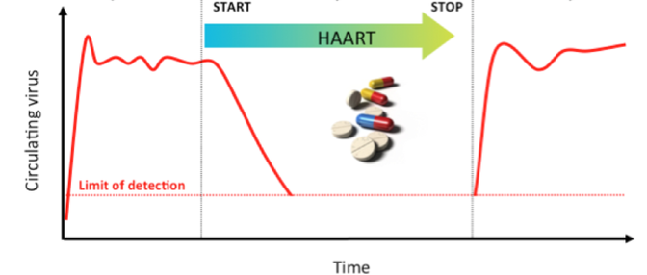
The Latent HIV Reservoir and Opportunities for Cure
Introduction
Eradicating HIV from latent reservoirs = intractable challenge
  Key barrier to a cure
HIV exploits immunological memory, shielded in long-lived memory T cells
They are difficult to identify, found throughout the body, and very stable
ART during acute infection, especially for children, may lead to a smaller, low diversity reservoir
  Children may be a good population to test cure strategies
Persaud THPL0104

Slide 12
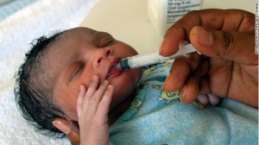
The Latent HIV Reservoir and Opportunities for Cure
Mississippi Baby Case
Infant was administered three-drug ART starting 30 hours after birth, after HIV DNA and RNA were detected in blood samples
  remained on ART 18 months
ART was ceased at 18 months
  At this time no:
    Plasma viremia
    HIV antibodies
    Latent reservoir
    Protective genetic alleles
    Evidence of immune response
However viral rebound 27 months later
  Small latent reservoir can lay dormant for two years
Early ART delayed viral rebound by significantly reducing the size of reservoir in CD4+ CCR5+ T cells in the gut mucosa
Persaud THPL0104

Slide 13
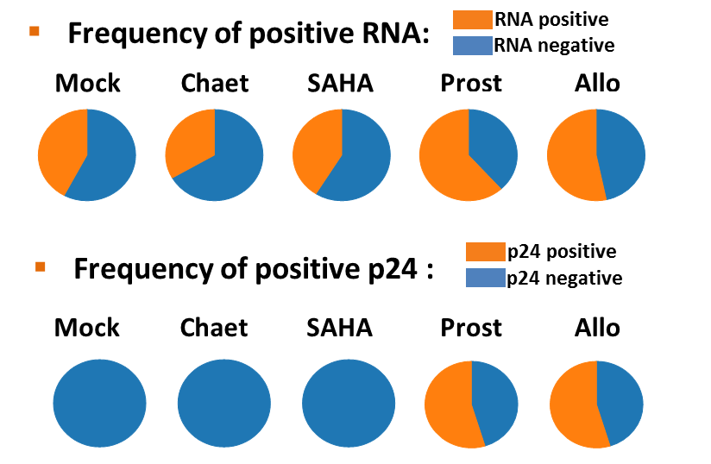
The Latent HIV Reservoir and Opportunities for Cure
Measuring the HIV Reservoir
State of the art assays only identify infected cells where the virus is actively replicating
Need to identify a marker for cells infected with latent virus that remain suppressed during treatment, but which start to replicate after treatment interruption
Single molecule assays:
  p24 quantification at the single infected cell level
  Has offered a nearly 3-log boost in sensitivity
Differentiating between cells with latent infection and those that are uninfected remains the key challenge
Passaes et al submitted
Sáez-Cirión TUWS0702

Slide 14
The Latent HIV Reservoir and Opportunities for Cure
SEARCH 019 Study
Effect of vorinostat, hydroxychloroquine and maraviroc on viremia following treatment interruption
SEARCH 019: proof-of-concept study
15 patients initiated ART during early stages of acute infection (Fiebig 3 and 4), continued at least 2 years before randomisation.
10 patients randomised to receive, in addition to ART:
Treatment interruption
Vorinostat | 400mg/day | 14 days on/off | 3 cycles (10 weeks) | Latency reversing agent
Hydroxychloroquine | 200mg/dose | 2 times/day | 10 weeks | Immunomodulating agent
Maraviroc | 600mg/dose | 2 times/day | 10 weeks | Entry inhibitor
Kroon TUAX0101LB
Notes:
KROON
Background: Individuals who initiate antiretroviral therapy (ART) during acute HIV infection (AHI) have a lower frequency of latently infected cells and could have a greater chance for viremic control after treatment interruption (TI).
Methods: A randomized study of vorinostat/hydroxychloroquine/maraviroc (VHM, n= 10; 8 Fiebig III/ 2 Fiebig IV) plus ART vs. ART alone (n=5; all Fiebig III) given for 10 weeks, followed by TI at week 10 was conducted in individuals treated since AHI with viral load (VL) suppression for >48 weeks and CD4 ≥ 450 cells/mm3. The VHM arm received 3 cycles of vorinostat 400mg/day (14 days on/14 days off) plus hydroxychloroquine (400mg/day) and maraviroc (1200mg/day). VL was monitored weekly after TI. ART was resumed when confirmed VL >1000 copies/ml.
Results: The participants were mainly male who were treated during Fiebig III AHI with high CD4 and about 3 years of VL suppression. Two individuals in the VHM arm had serious adverse events, and one withdrew from the study for renal insufficiency and thrombocytopenia.
Fourteen participants underwent TI (9 VHM+ART, 5 ART) and all experienced VL rebound with no difference between arms (range: 2-11 weeks). One participant in the ART arm had viremic control for 11 weeks. None had acute retroviral syndrome. All achieved VL suppression following ART and there was no change in genotypic resistance profile.
Conclusions: In this proof-of-concept study, all 14 individuals who initiated ART during Fiebig III/IV AHI experienced VL rebound following treatment interruption regardless of VHM treatment.

Slide 15
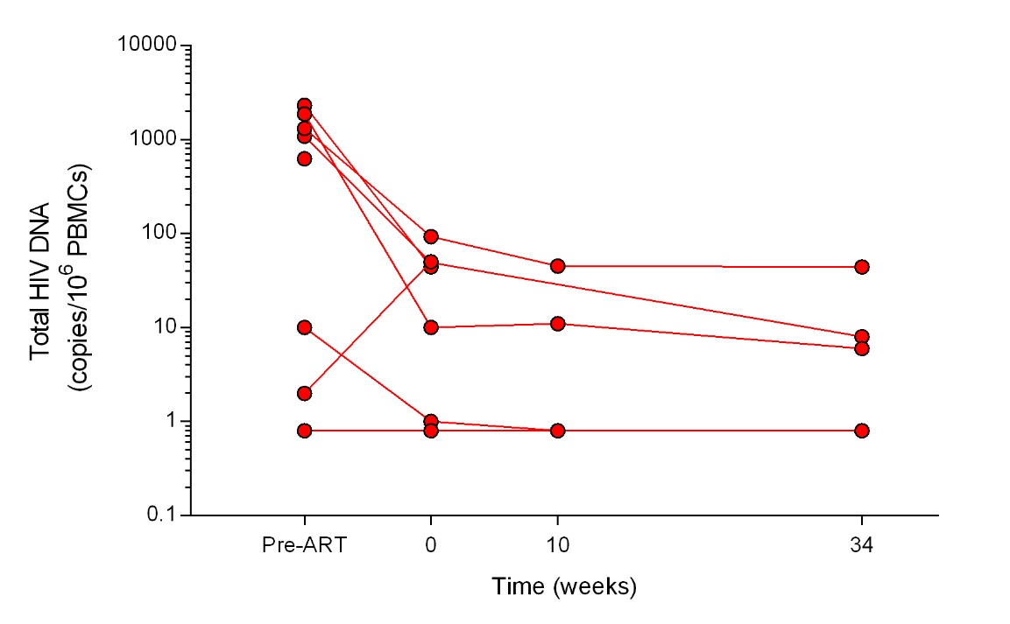
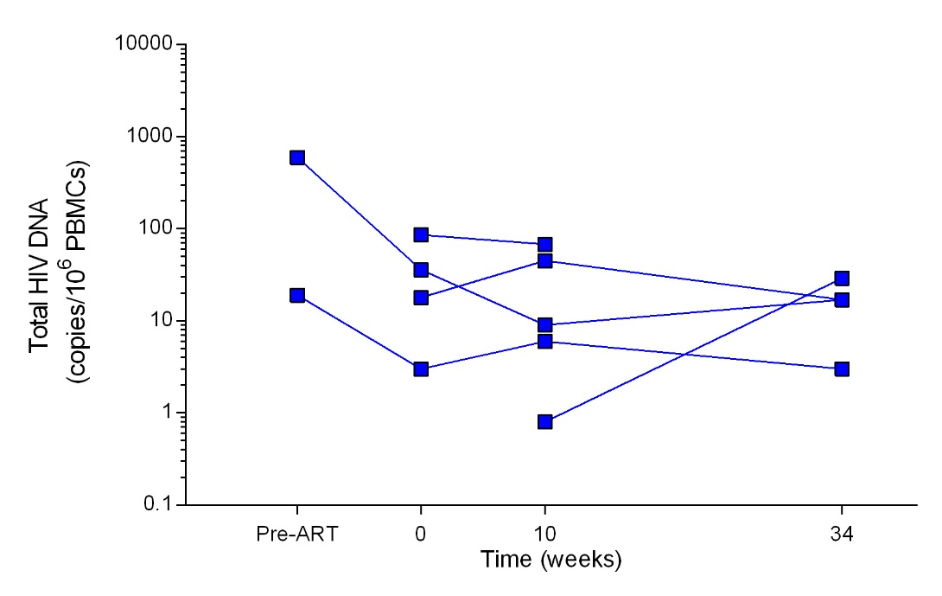
The Latent HIV Reservoir and Opportunities for Cure
SEARCH 019 Study
Disappointing results:
  Adjunctive therapy (VHM) did not decrease time to virologic rebound or decrease total HIV DNA in peripheral blood mononuclear cells (latent reservoir)
  Two people in intervention arm had serious adverse events
Conclusion: alternative strategies to reduce or eliminate HIV reservoirs are needed
VHM
ART
Kroon TUAX0101LB
Notes:
KROON
Background: Individuals who initiate antiretroviral therapy (ART) during acute HIV infection (AHI) have a lower frequency of latently infected cells and could have a greater chance for viremic control after treatment interruption (TI).
Methods: A randomized study of vorinostat/hydroxychloroquine/maraviroc (VHM, n= 10; 8 Fiebig III/ 2 Fiebig IV) plus ART vs. ART alone (n=5; all Fiebig III) given for 10 weeks, followed by TI at week 10 was conducted in individuals treated since AHI with viral load (VL) suppression for >48 weeks and CD4 ≥ 450 cells/mm3. The VHM arm received 3 cycles of vorinostat 400mg/day (14 days on/14 days off) plus hydroxychloroquine (400mg/day) and maraviroc (1200mg/day). VL was monitored weekly after TI. ART was resumed when confirmed VL >1000 copies/ml.
Results: The participants were mainly male who were treated during Fiebig III AHI with high CD4 and about 3 years of VL suppression. Two individuals in the VHM arm had serious adverse events, and one withdrew from the study for renal insufficiency and thrombocytopenia.
Fourteen participants underwent TI (9 VHM+ART, 5 ART) and all experienced VL rebound with no difference between arms (range: 2-11 weeks). One participant in the ART arm had viremic control for 11 weeks. None had acute retroviral syndrome. All achieved VL suppression following ART and there was no change in genotypic resistance profile.
Conclusions: In this proof-of-concept study, all 14 individuals who initiated ART during Fiebig III/IV AHI experienced VL rebound following treatment interruption regardless of VHM treatment.

Slide 16
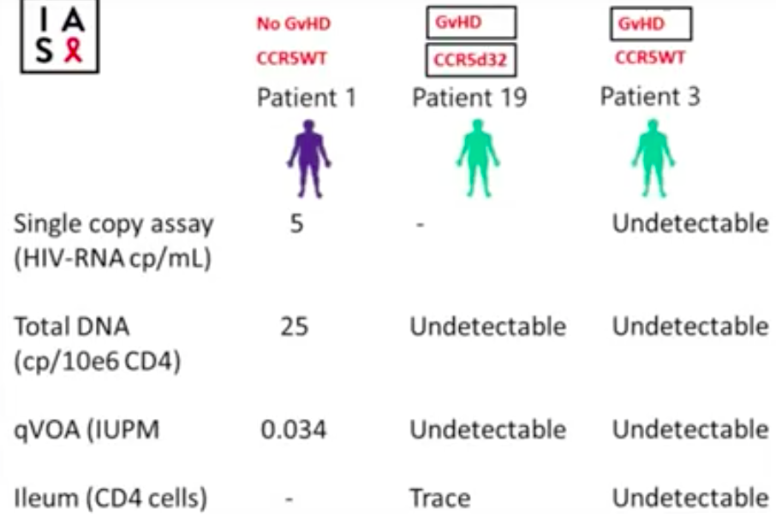

The Latent HIV Reservoir and Opportunities for Cure
Allogeneic Stem Cell Transplantation
“Berlin patient” involved an allogeneic stem cell transplant (SCT) from a donor who was homozygous for CCR5Δ32
EpiStem consortium aims to guide clinicians of HIV positive patients who require an SCT and gather observational data
Preliminary analysis shows a systematic reduction of reservoir to very low levels post SCT (ART is maintained).
In two cases of follow-up > 3 years, unable to detect infectious virus in blood independent of the CCR5 status of the donor. In tissue, only traces of HIV DNA could be detected
Hypothesis: the “graft versus HIV-1 reservoir effect” contributes to the clearance of the viral reservoir
Wensing THAA0105
Notes:
WENSING
Background: To date, the only and most compiling evidence of a medical intervention that has been able to cure HIV-1 infection (the “Berlin patient”), involved an allogeneic stem cell transplant (SCT) from a donor who was homozygous for CCR5Δ32. Although this high-risk procedure is only indicated for certain hematological malignancies, the strategy raised tremendous scientific potential to gain insight in the mechanisms of HIV eradication.
Methods: The EpiStem consortium aims to guide clinicians of HIV infected patients who require an SCT in donor search and CCR5 screening, ethical regulations, the SCT procedure, sampling procedures and in depth investigations to study HIV persistence. The patients are included in the EPISTEM observational cohort. Detailed analysis of the cohort should provide insight as to whether additional factors such as conditioning regimen, total body irradiation and graft versus host disease may contribute to the eradication of the potentially infectious viral reservoir in addition to the lack of a functional CCR5 receptor.
Results: Nearly 30,000 cord blood units in multiple European blood banks and more than 1.000.000 adult donors have been genotyped for CCR5 to generate a registry of CCR5Δ32 available donors. Twenty HIV positive patients with diverse hematological malignancies have been registered to the EPISTEM cohort. Since 2012, 13 patients have been transplanted; 4 with a CCR5Δ32, 1 with a heterozygous, and 8 with a CCR5 WT donor. In 3 cases the donor cells came from cord blood and in 10 cases from an adult donor. So far, 5 patients have successfully passed the 12 months follow-up after transplantation, and 8 patients have died after transplantation, despite achieving full donor chimerism in most cases. Preliminary analysis of virological and immunological data from blood and tissue samples shows a systematic reduction of HIV-1 reservoirs to very low levels.
Conclusions: EPISTEM is actively recruiting new cases and continues to systematically investigate HIV persistence over time to gain insight in potential HIV-1 eradication.

Slide 17
The Latent HIV Reservoir and Opportunities for Cure
New Concepts in Cure Research
Excision of HIV-1 DNA by gene editing:
  CRISPR/Cas9 nuclease system uses guide RNA to find DNA sequences of interest, which is then excised from the cell’s genome
Whole genome sequencing demonstrated that provirus was not transcriptionally suppressed after treatment but was removed from the cell’s genome
Using this technique viral DNA could be excised from PBMC from HIV-infected individuals treated with the CRISPR/Cas9 system ex vivo and in vivo using transgenic mice and rat animal models
Kaminski THAA0102
Notes:
KAMINSKI
Background: Cure strategy for HIV-1 infection and AIDS should include methods that directly eliminate the proviral genome from HIV-1 positive cells and/or eliminate infected cells harboring latent virus.
Methods: We modified the CRISPR/Cas9 system to enable recognition of specific DNA sequences positioned within the HIV-1 promoter spanning the 5´ long-terminal repeats (LTR) and various viral genes including Gag. We applied CRISPR/Cas9 by several methods including plasmid, lentiviral and Adeno-associated virus to cell models for latency, in vitro HIV-1 infection of CD4+ T-cells, CD4+ T-cells from HIV-1 positive patients and transgenic animals encompassing integrated copies of HIV-1 to assess efficacy of our gene editing molecule in excising a segment of HIV-1 for cells in in vitro, ex vivo and in vivo systems.
Results: We demonstrated complete elimination of HIV-1 DNA from latently infected cells, a drastic decrease in HIV-1 replication in in vitro replication of PBMCs and CD4+ T-cells, suppression of HIV-1 expression in PMCs and CD4+ T-cells for HIV-1+/AIDS patients due to InDel mutations in the viral genome and excision of viral DNA positioned between the LTR and Gag gene in tissues of HIV-1 transgenic mice upon injection of AAV-CRISPR/Cas9.
Conclusions: CRISPR/Cas9 can offer an effective, precise, efficient and safe strategy for eradication of HIV-1 in several laboratory model systems and can be considered for its advancements toward clinical trials.

Slide 18
The Latent HIV Reservoir and Opportunities for Cure
New Concepts in Cure Research
Gene editing of the CCR5 co-receptor locus in hematopoietic stem/progenitor cells
Promising CCR5 modified CD34+ engraftment
  Virus did come back after ART
Future directions would include a T-cell approach to target latent virus
Peterson THAA0103
Notes:
PETERSON
Background: Gene editing of the CCR5 coreceptor locus in hematopoietic stem/progenitor cells (HSPCs) is a promising therapy for HIV infection. We have previously demonstrated the feasibility of this approach in nonhuman primates. Here, we leverage our expertise with gene editing in the pigtailed macaque, M. nemestrina to interrogate the clonal persistence, trafficking, and antiviral efficacy of CCR5-edited cells. Our objectives were to understand how individual gene-edited HSPCs persist following autologous transplantation and virus infection, determine whether HSPC-derived, gene-edited progeny traffic to viral reservoir tissues, and develop strategies to increase the number of these cells in vivo.
Methods: Zinc Finger Nucleases (ZFNs) are used to target the CCR5 locus in macaque HSPCs. Gene edited HSPCs are transplanted into animals either prior to infection with simian/human immunodeficiency virus (SHIV), or in SHIV-infected animals that are treated with a combination antiretroviral therapy (cART) regimen designed to approximate a well-suppressed HIV+ patient. Edited cells are measured in peripheral blood, bone marrow, gastrointestinal (GI) tract, lymph nodes, and at necropsy in a panel of 25 tissues, using methods including deep sequencing.
Results: We observe up to 14-fold enrichment of CCR5-gene edited memory CD4+ T-cells in SHIV-infected animals, consistent with virus-dependent selection against CCR5 wt memory CD4+ T-cells. Gene edited cells are found in a broad array of anatomical sites. These include tissues that we have identified as viral reservoirs in our model, namely GI tract and lymph nodes. Spatial and temporal tracking of CCR5 mutations suggests that gene edited cells persist long-term, and are polyclonal. Homology directed repair (HDR) pathways can be exploited in macaque CD34+ HSPCs, facilitating knock-in of selectable markers at the disrupted CCR5 locus.
Conclusions: Our gene editing strategy results in stable engraftment of CCR5-mutated and SHIV-resistant HSPCs and their progeny in blood, and in tissues known to serve as viral reservoirs. Importantly, gene-edited CD4+ T-cells undergo positive selection during active infection, further supporting the validity of this approach in the clinic. Our preliminary ex vivo HDR data suggest that these gene-edited cells could be engineered to undergo positive selection without the need for ongoing viral replication.

Slide 19
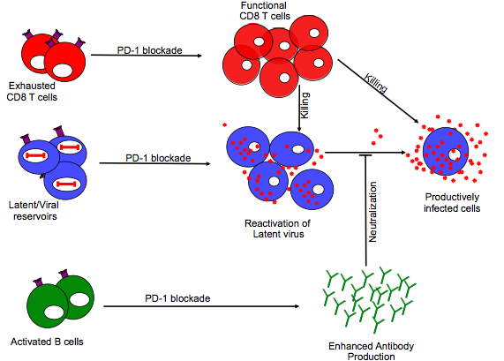
The Latent HIV Reservoir and Opportunities for Cure
New Concepts in Cure Research
PD-1 blockade administered during the initiation of ART and under suppressive ART
PD-1 = molecule and marker of the reservoir, and of exhausted T cells and B cells
Some promising data in macaques - combination of activating the reservoir and then augmenting immunity may be a possible cure strategy
Mylvaganam THAA0206
Notes:
MYLVAGANAM
Background: The expression of the inhibitory receptor programmed death-1 (PD-1) on anti-viral CD8 T cells and virally infected CD4 T cells provides an immunological signature for both T cell dysfunction and viral latency during chronic SIV/HIV infection. We hypothesized that PD-1 blockade administered during the initiation of anti-retroviral therapy (ART) and under fully suppressive ART would have direct effects on both dysfunctional CD8 T cells and latently infected CD4 T cells. To test our hypothesis we developed a primatized anti-human PD-1 Ab to allow for repeated infusions in rhesus macaques (RMs) and administered PD-1 blockade to chronically SIV infected RMs in combination with ART.
Methods: SIVmac251 infected RMs were administered 5 infusions (over 14 days) of a 3mg/kg dose of primatized anti-PD-1 Ab 10 days prior to the initiation of ART. About 8 months post ART, RMs received 3 monthly infusions of 10mg/kg anti-PD-1 or saline. ART was interrupted at 2 weeks after the final PD-1 Ab infusion.
Results: PD-1 blockade administered during the initiation of ART enhanced proliferation of anti-viral CD8 T cells (p=0.02), increased their cytotoxic potential (p=0.04) and polyfunctionality (p=0.01). Importantly, the PD-1 Ab treated animals showed more rapid viral suppression (42 days in the PD-1 group versus 140 days in saline group; p = 0.01) and greater reconstitution of Th17 cells in the rectal mucosa (p = 0.01) following initiation of ART. Moreover, PD-1 blockade administered under suppressive ART resulted in transient but significant increases in viremia, suggesting possible effects on destabilizing the latent viral reservoir. Following ART interruption, PD-1 Ab treated animals showed up to 80-fold reduction in set point viremia compared to set point levels prior to initiation of ART.
Conclusions: These results reveal for the first time the potential of PD-1 blockade both on restoring anti-viral CD8 T cell function and possibly destabilizing the viral reservoir under ART. They highlight the potential of PD-1 blockade to work synergistically with other therapeutic agents such as vaccines and latency reversing agents to effectively diminish HIV reservoir under ART as a means to establish a functional cure.

Slide 20
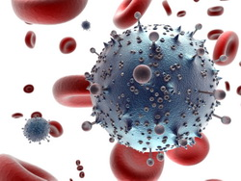
Basic Implications of Treating Early
No Replication During ART?
No Evidence Of Ongoing Replication In Tissue Compartments During ART
3 case studies, individuals initiated ART soon after diagnosis
Viral suppression for 8, 14 and 16 years respectively
Biopsies post colonoscopy (2 patients), autopsy (1 patient)
Large number of body tissues were phylogenetically analysed
  Ongoing cycles of HIV replication are detectable in tissues by accumulation of genetic change
No evidence of ongoing cycles of HIV replication in tissue compartments and peripheral blood mononuclear cells (PBMC) in study participants undergoing long term ART
Bozzi THAA0104LB
Notes:
BOZZI
Background: Sources of HIV persistence during combination antiretroviral therapy (cART) remains uncertain, and the contribution of active cycles of HIV replication in tissue compartments is unknown. Genetic analyses are sensitive measures to detect ongoing cycles of virus replication, particularly in individuals who undergo cART early after infection, when HIV populations are relatively monomorphic and increases in genetic diversity are easily detectable. To investigate whether ongoing replication occurs in tissues, we studied HIV populations in blood and anatomic compartments from 3 individuals who initiated antiretroviral therapy shortly after HIV infection and maintained viral suppression for > 8y.
Methods: Samples from three individuals in IRB-approved studies were studied. Individuals started cART soon after infection, maintained HIV RNA < 50 c/ml for 8-16y, and underwent autopsy for primary effusion lymphoma (N=1), or colonoscopy (N=2). HIV from autopsy was quantified (RT-PCR), and HIV sequences (pro-pol, 1200 nt) were obtained from tissues and peripheral blood lymphocytes (PBL) using single genome sequencing (SGS). Sequences were aligned, subjected to phylogenetic (MEGA), and compartmentalization (Slatkin-Maddison, FST, geographic subdivision) analyses; 263 sequences from autopsy and 293 from individuals undergoing colonoscopy were analyzed.
Results: HIV DNA was detected in most tissues at autopsy (median 1.8 copies/1e6 cells, range 1-75/1e6 cells). HIV had limited genetic diversity in tissues and PBL (average pairwise difference, APD 0.3 - 0.6%). From the autopsy, PBL (N=124), spleen (38), lymph node (30), ileum (30), jejunum (12), colon (5), effusion cells (10), kidney (5), lung (3), testes (1) were obtained; no HIV was recovered from frontal lobe, spinal cord, or the cell-free effusion fluid. HIV populations were well-mixed in tissues and non-divergent from PBL-derived HIV, with no evidence of compartmentalization in any tissue. Identical hypermutated sequences in PBL and several tissues demonstrated distribution of clonally expanded cells had occurred. In 2 individuals undergoing colonoscopy, analysis of HIV from ileum, colon, and PBL revealed no evidence of ongoing replication and no divergence from pretherapy plasma RNA obtained 12-16 years prior to colonoscopy.
Conclusions: No evidence of ongoing replication was detected in tissues compared to peripheral blood in individuals undergoing cART, suggesting combination antiretroviral therapy blocks active HIV replication, including in tissues.

Slide 21
Basic Implications of Treating Early
FRESH Cohort
Early treatment of hyperacute HIV infection impacts phenotype and clonal repertoire of HIV-specific CD8⁺ T cells
FRESH cohort:
  10 individuals who initiated ART in Fiebig stage 1, plus 12 individuals with untreated hyperacute HIV infection
Longitudinal analysis of HIV-specific CD8+ T cell responses
Very early ART is associated with measurable CD8+T cell responses that are phenotypically and functionally superior to untreated hyperacute HIV infection
Data suggest that prompt curtailment of HIV replication results in more functionally competent immune responses
Ndhlovu WEAA0104
Notes:
NDHLOVU
Background: Although natural immunity in some cases can lead to prolonged HIV suppression, it does not completely eliminate the virus. Consequently most of what we know regarding the nature of HIV-specific responses is based on inadequate responses generated in the setting of high levels of persistent plasma viremia and marked CD4 cell decline in acute infection. We investigated the impact of antigen withdrawal through very early treatment of hyperacute infection on the functional qualities of HIV-specific CD8+ T cell responses.
Methods: 10 subjects who initiated ART in Fiebig stage 1 and 12 subjects with untreated hyperacute HIV infection (UTx) were studied. We conducted a comparative longitudinal analysis of the clonality, phenotype and functional profile of HIV-specific CD8+ T cell responses generated during treated and untreated hyperacute infection. HIV-specific CD8+ T cells were measured using MHC class I tetramers. T cell receptors (TCR) were sequenced from tetramer sorted CD8+ T cells.
Results: In spite of rapid plasma virus suppression and blunted peak viremia, HIV-specific CD8+ T cell responses were detected in 7 of 10 (70%) ETx subjects studied, compared to 90% detection rate in UTx. Phenotypic analysis of tetramer+ cells showed that responses in ETx subjects expressed higher levels of interleukin-7 receptor alpha (CD127+), a marker associated with the development of long term memory, compared to untreated subjects (=0.0001). ETx responses were more fully differentiated with terminally differentiated effector cells account for the 90% of the responses (p=0.0001) whereas untreated responses were less differentiated, with effector cells account for 90% of the response (p=0.0001). Combined tetramer ICS staining of 2 ETx had >70% tetramer+ cells secreting IFN-g compared to < 20% in UTx. Furthermore, longitudinal TCR analysis of tetramer sorted cells obtained from ETx revealed striking clonal stability over time whereas UTx responses were characterized by successive waves of clonal loss and emergency of new clonotypes over time.
Conclusions: We show that very early ART is associated with measurable CD8+T cell responses that are phenotypically and functionally superior to untreated hyperacute HIV infection. Our data suggest that prompt curtailment of HIV replication result in more functionally competent immune responses with potential for long-term survival.

Slide 22
Basic Implications of Treating Early
Unspliced RNA as Biomarker
Cell-associated HIV-1 unspliced RNA level as a biomarker to predict duration of virological control post early ART
46 patients that received 24 or 60 weeks of temporary ART initiated at primary HIV infection
Cell-associated HIV-1 unspliced RNA level independently predicted both time to virological suppression and time to virological rebound
Cell-associated HIV-1 multiply spliced RNA level independently predicted disease progression (CD4+ T-cell loss) after interruption of early ART, while unspliced RNA was not predictive
It appears that reactivation of HIV after interruption of ART and subsequent CD4+ T-cell loss are driven by different mechanisms
Pasternak TUAA0104
Notes:
PASTERNAK
Background: For the improved design of strategies towards HIV-1 functional cure, it is important to identify biomarkers that could predict the duration of post-treatment virological control.
Methods: We studied 46 patients that received 24 or 60 weeks of temporary ART initiated at primary HIV infection (PHI). Patients were treated with a quadruple triple-class ART regimen. Cell-associated HIV-1 nucleic acids were quantified by seminested real-time PCR.
Results: All patients achieved virological suppression (VS) (plasma HIV-1 viremia < 50 copies/ml) with a median of 21 weeks. We first assessed the predictive power of plasma viremia, total HIV-1 DNA, unspliced (US) cell-associated HIV-1 RNA, CD4+ T-cell count, and CD4:CD8 ratio, measured at PHI, for the time to VS. In the univariate analysis, both plasma viremia and US RNA were predictive for time to VS (p=0.016 and p=0.0033, respectively, log-rank test). In the multivariate Cox regression, US RNA at PHI was the only significant predictor of the time to VS (HR=0.65 per 1 log10 increase in US RNA, 95% CI, 0.48-0.87, p=0.0043). Subsequently, the same biomarkers were longitudinally quantified every 12 weeks during ART. All 45 patients who discontinued ART experienced virological rebound (VR) (plasma viremia >50 copies/ml) within 9 months after therapy interruption. We assessed the predictive power of the last measurements of the biomarkers on ART before the therapy interruption, as well as of the duration of temporary ART, for the time to VR (the duration of post-treatment virological control). Again, US RNA was the only significant predictor of the time to VR (HR=0.29 for patients with US RNA levels below vs. above the median, 95% CI, 0.10-0.83, p=0.021, log-rank test).
Conclusions: In summary, in this cohort of patients treated at PHI, cell-associated HIV-1 US RNA level was the sole independent predictor of both virological suppression on ART and post-treatment virological control after ART discontinuation. Further exploration of the potential of this biomarker as a predictor of post-treatment control in large-scale clinical trials aimed at HIV functional cure is warranted.

Slide 23
Vaginal Microbiome and HIV Acquisition
Introduction
Background:
  Epidemiological studies have previously identified an association between bacterial vaginosis and HIV prevalence and incidence
  However, lack of clarity on which BV-associated species increase HIV susceptibility
Earlier analysis from CAPRISA 004 cohort (large RCT of 1% tenofovir vaginal gel for HIV prevention, South Africa):
  HIV seroconversion was associated with raised genital inflammatory cytokines (including chemokines MIP-1α, MIP-1β, and IP-10)
  Cytokine concentrations were persistently raised (for about one year before infection), with no readily identifiable cause, including STIs
Further analyses presented at AIDS 2016
TUSS06
Notes:
On previous studies, see for example Atashhili J et al. Bacterial vaginosis and HIV acquisition: a meta-analysis of published studies. AIDS 22 (12):1493-1501, 2008.
Previous CAPRISA analysis: Masson L, et al. Genital inflammation and the risk of HIV acquisition in women. Clinical Infectious Diseases 2015.

Slide 24
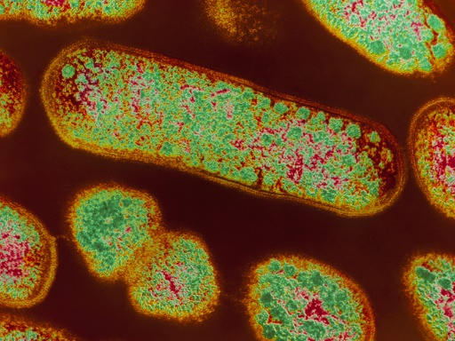
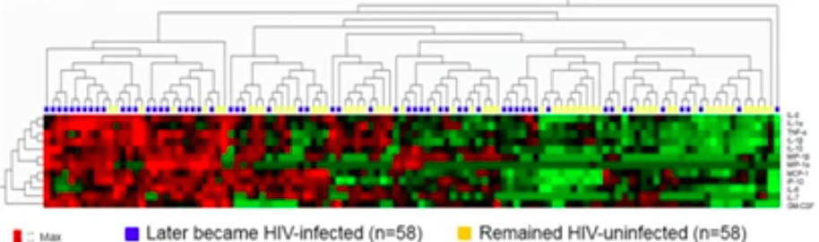

Vaginal Microbiome and HIV Acquisition
Prevotella Bivia
119 CAPRISA participants, V1-V3 16S rDNA sequencing
Average 25,839 sequences per vaginal swab; identified a total of 1368 species
Vaginal microbiome cluster CST4 is linked with genital inflammation and HIV acquisition
Overgrowth of uncommon bacteria Prevotella bivia strongly associated with:
  Genital inflammation: AOR 19.2 (95% CI: 4.0-92.4)
  HIV acquisition: AOR 12.7 (95% CI: 2.1-77.8)
Potential mechanism of action: potent Lipopolysaccharide (LPS) response
  LPS = well-known immuno-stimulatory molecule in HIV infection
Women with CST4 and women heavily populated with P. bivia have significant enrichment of LPS biosynthesis pathways
Passmore & Williams TUSS0604
Notes:
Sequencing analyzed the abundance of a specific bacteria in a woman's microbiome, relative to the other bacteria in the vagina.
P bivia is not sexually transmitted and it is the predominant vaginal bacteria in only about 15% to 20% of women. Among the 22 women with genital inflammation who became HIV-positive, 41% had P bivia (more than 1% of vaginal microbiome).
Lipopolysaccharide (LPS) acts as a toxin to stimulate immune activity and promote genital inflammation, raising levels of pro-inflammatory cytokines and attracting CD4 cells that are vulnerable to HIV infection.

Slide 25
Vaginal Microbiome and HIV Acquisition
Lactobacillus Dominant & PrEP
Lactobacillus dominant vaginal microbiome and PrEP effectiveness
Metaproteomic analysis of 3,334 unique proteins from 688 CAPRISA 004 participants.
  62 acquired HIV
  407 Lactobacillus dominant (‘good’ bacterial environment)
  281 non-Lactobacillus dominant (‘bad’ bacterial environment)
Lactobacillus dominant and non-Lactobacillus dominant women had similar baseline clinical, behavioral, and demographic characteristics as well as sexual behavior and gel adherence during the trial.
407 Lactobacillus dominant
281 non-Lactobacillus dominant
205 Tenofovir arm
(50.4%)
202 Placebo arm (49.6%)
140 Tenofovir arm (49.8%)
141 Placebo arm (50.2%)
Burgener & Klatt TUSS0605
Notes:
HIV-1 incidence per 100 person-years
Lactobacillus dominant, tenofovir gel: 1.9
Lactobacillus dominant, placebo: 8.5
Non-Lactobacillus dominant, tenofovir gel: 6.4
Non-Lactobacillus dominant, placebo: 8.6

Slide 26
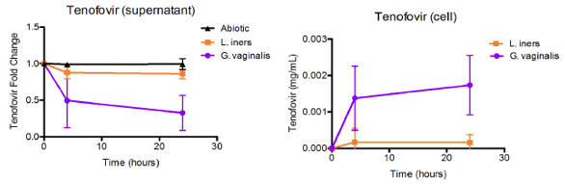
Vaginal Microbiome and HIV Acquisition
Lactobacillus Dominant & PrEP
Lactobacillus dominant vaginal microbiome and PrEP effectiveness
Tenofovir gel was highly protective in women with Lactobacillus dominance and >50% adherence to gel
  Lactobacillus dominant: 78% (95% CI: 29-95) HIV-1 protection effectiveness
  Non-Lactobacillus dominant: 26% (95% CI: -98-73) HIV-1 protection effectiveness
Potential mechanism: biodegradation of tenofovir by vaginal bacteria
In vitro cell cultures: tenofovir levels remained high in the presence of Lactobacilli but rapidly depleted when mixed with Gardnerella vaginalis (which predominates in the vagina when lactobacillus levels are low)
Burgener & Klatt TUSS0605

Slide 27

Vaginal Microbiome and HIV Acquisition
Implications
Vaginal pH screening and microbiota monitoring/treatment could reduce the risk of HIV acquisition in women, especially in Southern Africa
However previous trials have not shown that treating bacterial vaginosis reduces HIV acquisition – need to assess Prevotella bivia sub-groups
Findings may help explain disparity in PrEP efficacy between men and women (may not be entirely due to lower adherence)
CAPRISA 084 (oral PrEP demonstration project) is being amended to assess whether bacterial vaginosis screening & treatment improves PrEP efficacy
Why such a high of HIV acquisition following exposure?
LPS released by Prevotella bivia
Why such high variability in the efficacy of PrEP?
Tenofovir absorption by Gardnerella
Who is exposing young women to HIV?
Men with high viral loads in their thirties
Technologies to empower women to protect themselves from HIV infection
Young women at high HIV risk
Karim TUSS0606
Passmore & Williams TUSS0604
Burgener & Klatt TUSS0605

Slide 28
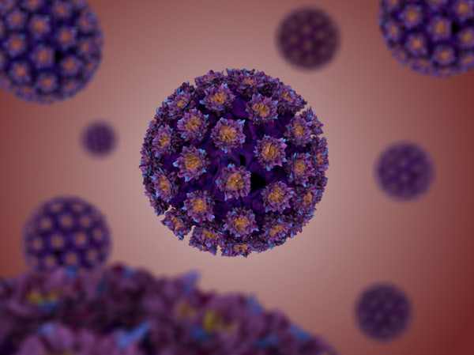
Other Correlates of HIV Acquisition
Human Papillomavirus (HPV)
Background:
  HPV is associated with higher rates of HIV acquisition
  But mechanism of the relationship is unclear
Analysis from CAPRISA 004 participants
HPV associated with:
  Elevated concentrations of cytokines associated with HIV infection (IL-8, MIP-1a, RANTES, IL-1a, IL-6)
  Influx of CD4+ T cell targets for HIV infection
Liebenberg TUPDA0105
Notes:
LIEBENBERG
Background: Young women bear a disproportionately high burden of sexually-acquired HIV infection. Human papillomavirus (HPV), a common sexually transmitted infection is a known contributor to this burden through its established association with higher rates of HIV acquisition. However, the mechanism of this relationship remains unclear. Here we explored whether the immunological impact of HPV promotes a mucosal immune environment that favours the establishment of HIV infection in young women in KwaZulu-Natal, South Africa.
Methods: This cohort study was nested within the CAPRISA 004 1% tenofovir gel study. Stored genital specimens from HIV uninfected participants (N=779) were utilized to determine the presence of 37 HPV genotypes using commercially available Linear Array kits. Concentrations of 48 cytokines were quantified by multiplexed ELISA assays, and the presence of CD4+ targets for HIV infection was investigated by flow cytometry. HIV infection was monitored monthly using two commercially available rapid tests, and confirmed by western blot and PCR.
Results: Baseline HPV prevalence was 73.8% (95% CI: 70.7, 76.9); with 70.3% of these infected participants presenting with an oncogenic strain. Participants with prevalent HPV infection were 2.8 times more likely to acquire HIV infection compared to those without HPV infection (HR 2.8, 95% CI: 1.3, 5.9, p=0.006). HIV risk was independent of the oncogenicity of HPV strains at baseline [(HPV oncogenic strains HR 2.9 (95% CI: 1.3, 6.1) vs non-oncogenic strains HR 2.8 (95% CI: 1.3, 6.1)], and was also increased in the presence of multiple concurrent infections (HR 4.0; 95% CI: 1.8, 8.8). Compared to HPV uninfected women, acquisition, clearance, or persistence of HPV were each significantly associated with >6 fold increased rates of HIV acquisition, and elevated concentrations of several cytokines associated with HIV infection (including IL-8, MIP-1a, RANTES, IL-1a, IL-6). Further, in line with cytokine involvement in chemotaxis, the influx of CD4+ T cell targets for HIV infection was associated with HPV infection (p=0.012).
Conclusions: These data provide a plausible causal immunological link between two viral infections of critical public health importance, and suggest that increased HPV vaccination rates in young women could have important additional HIV prevention benefits.

Slide 29
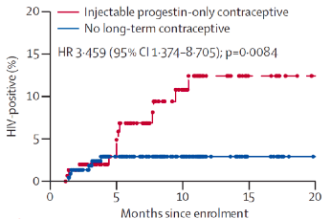
Other Correlates of HIV Acquisition
Injectable Hormonal Contraceptives
Background:
  Some data suggest that injectable progestin-only contraceptives are associated with HIV acquisition ; mechanism unclear
FRESH cohort, South Africa:
  Use of injectables associated with increased risk of acquiring HIV (HR 3.5; 95% CI 1.4-8.7)
  Independent of STIs or behavioural risk factors
Byrne TUPDA0104
Notes:
BYRNE
Background: Multiple observational studies have suggested that injectable progestin-only contraceptives (IPCs) are associated with HIV acquisition risk. However, the biological mechanism of this potential link was unclear. We aimed to understand immunological changes associated with exogenous and endogenous progestins that could mechanistically help explain a link to acquisition risk.
Methods: HIV-negative South African women ages 18-23 were enrolled in a prospective cohort study, the Females Rising through Education, Support and Health (FRESH) study. These women were at high risk of acquiring HIV, were living in Umlazi and were not pregnant. During the study, they were tested for HIV-1 two times per week; behavioral data along with blood and cervical samples were collected every three months.
Results: We characterized 423 HIV-uninfected women from the FRESH cohort. Of these, 152 women used IPCs, 222 used no long-term contraceptive and 43 used other forms of contraception. IPC users had a higher risk of acquiring HIV (12.06 per 100 person-years, 95% CI 6.41-20.63) compared to women using no long-term contraceptive (3.71 per 100 person-years, 1.36-8.07; adjusted hazard ratio 2.93, 95% CI 1.09-7.868, p=0.0326). In the cervix, CCR5+ CD4 T cells (HIV target cells) were 3.92 times more prevalent in IPC users than in women using no long-term contraceptive (p=0.0241). Of women using no long-term contraceptive, those in the luteal phase of the menstrual cycle had 3.25 times the frequency of cervical target cells compared with those in the follicular phase (p=0.0488).
Conclusions: High progestin levels, either due to the use of IPCs or the luteal phase of the menstrual cycle, are associated with an increased frequency of HIV target cells in the cervix compared to women with low progestin levels, in the follicular phase of the menstrual cycle. Because the female genital tract is the site of HIV entry in most women who become infected, the higher density of HIV target cells in a high-progestin state provides a potential biological mechanism for the epidemiological observation of increased HIV acquisition risk in IPC users.

Slide 30
Other Correlates of HIV Acquisition
Injectable Hormonal Contraceptives
Progestin exposure was associated with increased activated CCR5+ CD4 T cells (HIV target cells) in the female genital tract, but not in peripheral blood
In women using no long-term contraceptives:
  The luteal phase of the menstrual cycle was similarly associated with increased HIV target cell frequency in the cervix
Plausible mechanism for the observed increase in HIV acquisition for women using injectable progestin-only contraceptives
Peripheral blood
Cervix
Cervical CD4 T cells
Cervix
No LTC IPC
No LTC IPC
Byrne TUPDA0104
Notes:
BYRNE
Background: Multiple observational studies have suggested that injectable progestin-only contraceptives (IPCs) are associated with HIV acquisition risk. However, the biological mechanism of this potential link was unclear. We aimed to understand immunological changes associated with exogenous and endogenous progestins that could mechanistically help explain a link to acquisition risk.
Methods: HIV-negative South African women ages 18-23 were enrolled in a prospective cohort study, the Females Rising through Education, Support and Health (FRESH) study. These women were at high risk of acquiring HIV, were living in Umlazi and were not pregnant. During the study, they were tested for HIV-1 two times per week; behavioral data along with blood and cervical samples were collected every three months.
Results: We characterized 423 HIV-uninfected women from the FRESH cohort. Of these, 152 women used IPCs, 222 used no long-term contraceptive and 43 used other forms of contraception. IPC users had a higher risk of acquiring HIV (12.06 per 100 person-years, 95% CI 6.41-20.63) compared to women using no long-term contraceptive (3.71 per 100 person-years, 1.36-8.07; adjusted hazard ratio 2.93, 95% CI 1.09-7.868, p=0.0326). In the cervix, CCR5+ CD4 T cells (HIV target cells) were 3.92 times more prevalent in IPC users than in women using no long-term contraceptive (p=0.0241). Of women using no long-term contraceptive, those in the luteal phase of the menstrual cycle had 3.25 times the frequency of cervical target cells compared with those in the follicular phase (p=0.0488).
Conclusions: High progestin levels, either due to the use of IPCs or the luteal phase of the menstrual cycle, are associated with an increased frequency of HIV target cells in the cervix compared to women with low progestin levels, in the follicular phase of the menstrual cycle. Because the female genital tract is the site of HIV entry in most women who become infected, the higher density of HIV target cells in a high-progestin state provides a potential biological mechanism for the epidemiological observation of increased HIV acquisition risk in IPC users.

Slide 31
Other Correlates of HIV Acquisition
Injectable Hormonal Contraceptives
Separate study from CAPRISA 004 cohort
Other studies have suggested thinning of the epithelial barrier as a mechanism, but no association between injectable contraceptive use and vaginal epithelial thickness in this cohort
Women using injectable contraceptives had increased frequencies of CD4+ T cells in their vaginal stratified epithelium than those not using injectable contraceptives
CD68+ macrophages correlated with a broad panel of mucosal cytokines
Ngcapu WEAA0102
Notes:
NGCAPU
Background: Vaginal epithelial thinning and/or increased density of mucosal HIV-1 target cells are possible mechanisms by which injectable hormonal contraceptives (HCs) may increase risk for HIV-1 infection in HIV-1 negative women and the risk of her transmitting to her partner if infected. Here, the influence of injectable HCs on genital epithelial thickness, mucosal HIV-1 target cell density and depth in women with acute HIV infection was investigated.
Methods: CD4+ T cell and CD68+ macrophage density, both target cells for HIV infection, was measured by immunofluorescent staining in vaginal tissue biopsies from acutely-infected women who were either using injectable HCs or not using contraception. Concentrations of 48 cytokines measured in cervico-vaginal lavage (CVL). Blood CD4 counts and plasma viral loads were performed during acute infection and 12 months post-infection.
Results: Vaginal epithelial thickness was similar in women using injectable HCs compared to non-injectable HC users. The frequency of CD4+ T cells in the vaginal squamous epithelium of injectable HC users was significantly higher than non-injectable HC users (p=0.028). CD68+ macrophage cell density did not differ between women using injectable HCs and those not using injectable HCs, although macrophages were closer to the vaginal luminal surface in injectable HC users than those not using HCs (p=0.021). Furthermore, the frequency of mucosal CD68+ macrophages during the acute infection were positively associated with the concentration of the RANTES (beta coefficient (β)=0.779, p=0.024), MCP-1 (β=0.453, p=0.041), IP-10 (β=0.568, p=0.042), IL-7 (β=1.332, p=0.018), IL-9 (β=0.336, p=0.015), and IL-17 (β=1.058, p=0.007) in CVL, after adjusting for multiple comparisons.
Conclusions: Women using injectable HC users had increased frequencies of CD4+ T cells in their vaginal stratified epithelium than those not using injectable HCs. CD68+ macrophages correlated with a broad panel of mucosal cytokines. This study provides valuable insight into possible underlying mechanisms by which genital inflammation may increase HIV-1 risk and subsequent clinical phenotypes during HIV-1 disease course, such as viral set point.

Slide 32
Other Correlates of HIV Acquisition
Th17 Cells
Th17 : a Subset of Helper T cells
Mucosal transmission in the rhesus macaque model: challenge with a mixture of wildtype SIVmac239 and the LICh dual reporter
SIV-based dual reporter expression vector facilitates identification of transmission susceptible sites in the female reproductive tract
LICh helps identify sites of SIVmac239 infection in mixed challenge experiments
The primary targets of SIVmac239 early in vaginal transmission (48 hours) are Th17 cell (~70%) and immature dendritic cells (~20%)
These appear to be the only cell types that are susceptible to infection
Future research will include the identification of RNA transcripts by comparing local infected to non-infected tissue blocks from the same animal
Stieh WEAA0101
Notes:
STIEH
Background: Macaque vaginal challenge with SIV is utilized to reproduce the circumstances of male-to-female HIV transmission. This model has provided insights into HIV vaginal transmission, but the critical window of the earliest events taking place after mucosal exposure remains undefined.
Methods: We have recently developed a SIV-based dual reporter expression vector that facilitates the efficient identification of transmission susceptible sites in the rhesus macaque FRT after vaginal exposure. This system demonstrated that initial infection events can be widespread throughout the female reproductive tract (FRT), highly variable in their localization, and that T cells are the primary target in initial infection. Because this system efficiently identifies regions of susceptibility to infection in the FRT, we have determined that we can identify small foci of SIVmac239 infection 48 hours after vaginal challenge with a mixture of wildtype SIVmac239 and the LICh dual reporter. Utilizing this novel approach to SIV challenge, we routinely identify SIVmac239 infected cells revealing their localization and fates in the FRT 48 hours after vaginal challenge.
Results: Foci of infection with SIVmac239 are found throughout the female reproductive tract, from labia to ovary. We find that T cells are the major targets, and there is a strong bias for those with a Th17 phenotype. Infection of immature dendritic cells and macrophages is also observed representing approximately 25% of infected cells. 48 hours post inoculation, we find host responses to infection, evidenced by apoptosis, cell lysis, and phagocytosis of infected cells. RNA-Seq profiling of gene expression in tissues where SIV infection was established indicate that inflammatory responses and epithelial repair processes are occurring.
Conclusions: Defining the location and phenotype of SIV infected cell foci and early host responses informs the development of interventions designed to decrease HIV acquisition. Preferential infection of Th17 cells could explain the known conditions that increase HIV acquisition, including sexually transmitted infections and bacterial vaginosis. How these conditions precisely influence mucosal barrier function or the density of target cells remains to be determined. However, the system presented here provides essential sampling of these foci, facilitating characterization of the earliest host responses to SIV/HIV infection.

Slide 33
Basic and Translational Science Highlights
Promising developments:
Results of HVTN 100
Renewed energy in the vaccine field: three HIV vaccine related efficacy trials are in progress or soon to start
Improved understanding of correlates of infection, especially vaginal inflammation
Challenges:
Adjunctive therapy trial did not demonstrate efficacy
The continued challenge of viral latency

Slide 34
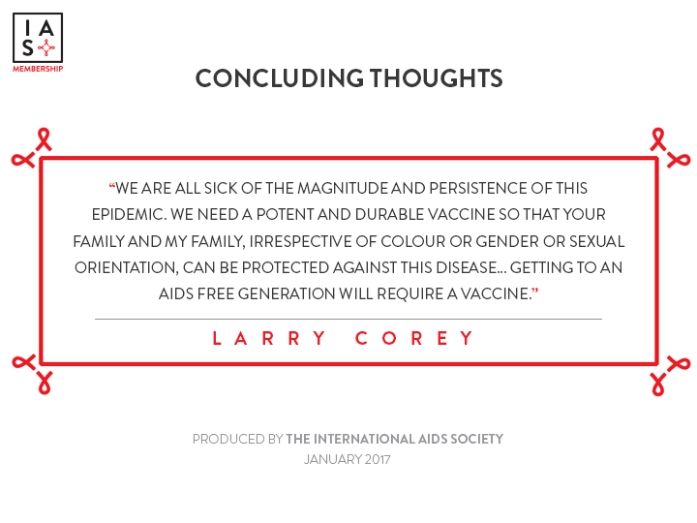
Concluding Thoughts
“We are all sick of the magnitude and persistence of this epidemic. We need a potent and durable vaccine so that your family and my family, irrespective of colour or gender or sexual orientation, can be protected against this disease… Getting to an AIDS free generation will require a vaccine.”
-Larry Corey

