Slide 1
HIV Cascade for MSM and Funding Gaps Assessment
Tools which LGBT Community can use for advocacy, leadership and governance in area of health protection

Slide 2
Tools for advocacy, leadership and governance
Under the “Rights to Health” project ECOM has developed tools allow LGBT community organizations to collect the good quality data describing accessibility and quality of HIV services for MSM and trans people
“The Cascade of the Continuum of HIV Care for MSM”
“Assessment of Funding Gaps in HIV Prevention Care and Support Targeting Gay Men, Other MSM and Trans People”

Slide 3
HIV Service Cascade: goal and objectives
Goal: Improve the advocacy and research capacity of community organizations
Objective 1 (programmatic): Increase quality of the data community organizations use for advocacy as well as for the planning of their own work.
Objective 2 (technical): Disaggregation of the data about MSM and trans people from the “general” HIV Treatment Cascade (so called “90-90-90”)
Objective 3 (technical): An attempt to build a cascade for HIV prevention services (or, at least, for some the most important of them, such as PrEP for instance)
Notes:
В рамках работы, качеству данных уделялось отдельное внимание. Кроме того, что инструмент ставит жесткие критерии для качества данных, которые ложатся в основу каскада, одной из задач исследования является оценить доступность и качество имевшихся в стране на момент исследования данных об услугах для МСМ.
Мы уверены, что успешная адвокация может быть только на основе качественных данных.

Slide 4
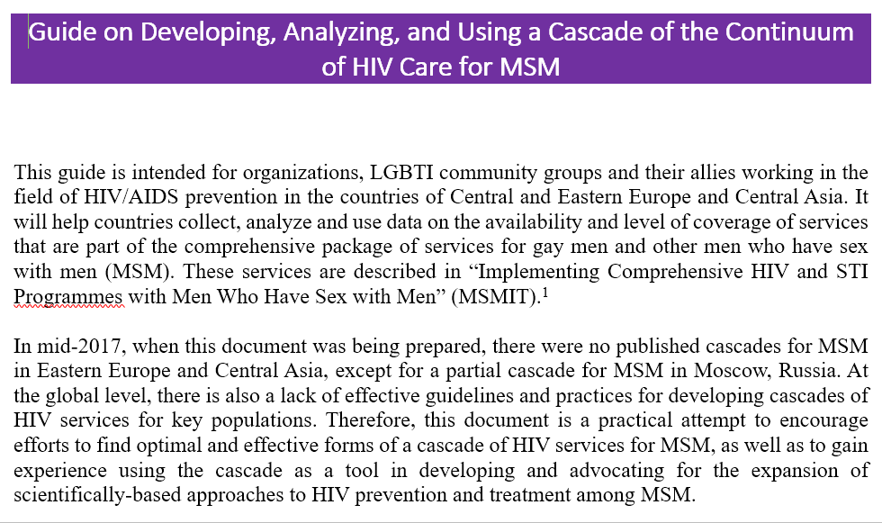
HIV Service Cascade : the tool and work in countries
Developed the «Guide on Development, Analysing and Using a Cascade of the Continuum of HIV Care for MSM»,
Conducted the training of national teems for developing the Cascade in counties,
Collected data in 5 countries: Armenia, Belarus, Georgia, Kyrgyzstan, Macedonia

Slide 5
HIV Service Cascade. Results: service coverage
 | Estimated number of MSM | Percent from adult male population | Estimated prevalence of HIV among MSM and number of HIV+ MSM | HIV+ MSM who know their HIV+ status | HIV+ MSM on ART | HIV+ MSM on ART with undetectable VL
Armenia | 12461 | 1,20% | 0,8% / 100 | 75 / 75% | 55 / 73,3% | 39 / 71%
Belarus | 60000 | 1,40% | 7,7% / 4621 | 259 / 5,6% | 211 / 81,5% | 172 / 81,5%
Georgia | 17200 | 1,32% | 20,7% / 4490 | 640 / 14% | 479 / 75% | 422 / 88%
Kyrgyzstan | 16900 | 1,20% | 6,6% / 1115 | 135 / 12,1% | 76 / 56,3% | 49 / 64,5%
Macedonia | 20214 |  | / 245 (or 1092) | 165 / 15% | 123 / 75% | 109 / 89%
Notes:
Это сводная таблица основных показателей, из которых складывается каскад.
Далее, чтобы было удобнее, мы увидим эти данные в графическом виде.

Slide 6
HIV Service Cascade. Results: service coverage
Notes:
Как видно, на данный момент, для большинства стран самой значительной является проблема привлечения МСМ к тестированию.
На остальных этапах каскада показатели значительно лучше, Так, в среднем примерно 70 процентов всех, МСМ, кто знает о своем положительном ВИЧ статусе, получают АРВ терапию, и более чем у 70% из получающих терапию достигнута неопределяемая вирусная нагрузка.
Исключение составляет лишь Армения, где, по данным Республиканского центра СПИД, оценочное число ВИЧ+ МСМ равно 100. Из них, информацию о своем ВИЧ статусе имеют 75 человек, получают АРВ терапию 55 человека, и у 39 достигнута неопределяемая вирусная нагрузка.

Slide 7
HIV Service Cascade. Results: comparing MSM with other groups (Georgia’s example)
Notes:
Сравнивая доступность и эффективность услуг тестирования и лечения для разных групп, мы видим, что существенное отличие существует именно на этапе тестирования. То есть на том этапе, который считается «входом» в услуги лечения. И, похоже, этот вход для МСМ – закрыт.
При этом, конечно, важно отметить, что эта работа недостаточно эффективна для всех групп населения. То есть тут мы видим пример равенства в отсутствии доступа…

Slide 8
HIV Service Cascade. Results: quality of data
Basic data required for development of Cascade are existing in countries, but there is lack of information needed for analysis of the cascade. So, it is possible to see the main gaps in the cascade, and quite difficult to understand reason caused these gaps.
Often MSM hide information on their sexual practices from medical servants. So the real coverage of HIV testing can be bigger than it has been shown by the research. On the other hand, such an absence of trust develops a big risk of late engagement in treatment and low treatment adherence.
Sometimes the procedure of IBBS can be violated. For instance, other men can be engaged in to a research as respondent instead of MSM.
MSM population size estimation in countries can be conducted not in line with international recommendations. A research’ procedure can be not transparent and LGBT community organizations are excluded from meaningful participation.
MSM belonging to internal and external migrants can refuse timely seeking for care and treatment due to absence of the right for free of charge medical service including HIV diagnosis. This can distort all data.
Data of trans people are almost not existing.

Slide 9
HIV Service Cascade: what’s next?
The Regional Overview summarizing national reports, including cases of HIV Prevention Cascades had been made in some countries.
Learning the lessons from the development of national cascades and then “polishing” the tool.
Planning of a next research on the HIV service for MSM cascade development and technical support to national organizations required for this.

Slide 10
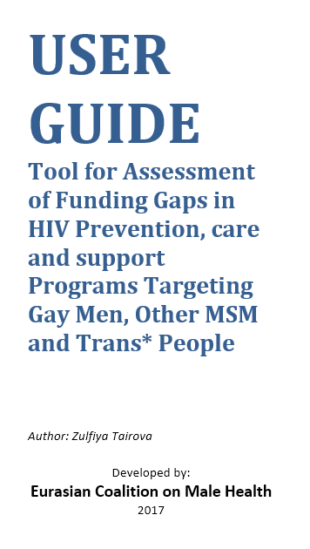
Funding Gaps Assessment: the tool and a plan of work
Goal: to evaluate the amount of funds lacking for ensuring access to the recommended by WHO comprehensive package of services for all MSM and trans people in need. By doing this we can evaluate effectiveness of the governmental investment to national HIV program.
Method: evaluation of the funding gaps by synthesis of data on HIV services unit costs, on existing funding and on number of MSM and trans people in need
The tool had been developed. The training of national teams conducted.
The data are gathering. Three countries are already provided reports. After finalization of all reports, the same as with the HIV Service Cascade, ECOM will “polish” the tool and issue a regional overview on Funding Gaps Assessment in 5 project’ countries.

Slide 11
Thank you for your participation!
Gennady Roshchupkin, ЕCОМ,
Community Health Systems Coordinator,
www.ecom.ngo
www.facebook.com/ecom.ngo/

