Slide 1


Educating Civil Servants
About Issues of Respecting Human Rights and Tackling Stigma
and Discrimination in Relation to Gays,
Other MSM, and Trans* People

Slide 2



Block 1
From Stereotypes to Discrimination
Aim: To provide information on how stereotypes influence decision-making and become the reason for discrimination

Slide 3

Stereotype
Stereotype is a firm, simplified idea about someone or something.
Stereotypes, as a readymade scheme of comprehension, allows the person to shorten the response time to the changing conditions of the surrounding environment.

Slide 4



Types of Stereotypes

Slide 5


Negative Stereotype
Prejudice

Slide 6

What is prejudice?
It’s a social construct with a distorted (often negative) content as a result of which the person comprehends certain social objects in a askew way.

Slide 7

In relation to whom is prejudice displayed more often than not?

Slide 8

Pyramid of Hate
Elimination of «others»
Acts of violence
Discriminatory actions
Avoiding the hated group
Verbal manifestation of antipathy

Slide 9

Stigma
Negative association of a person with anything shameful, non-prestigious, repulsive.
This phenomenon is relative to a stereotype and differs from it by a directedness on another person’s qualities.

Slide 10


Types of stigma manifestations
Cultural
Institutional
Personal
Interpersonal

Slide 11

What are your associations with the word DISCRIMINATION?

Slide 12

Discrimination
Action or inaction aimed at limiting a person’s or a social group’s rights and freedoms based on a particular legally protected attribute (biological, physical, or social), which is relevant to this person or group.

Slide 13
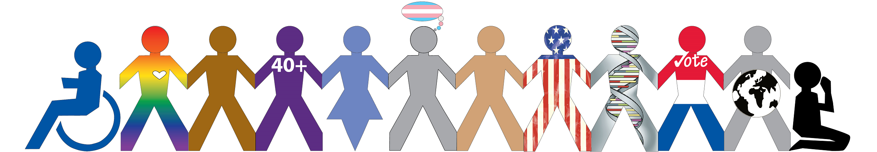
Attributes protected by law

Slide 14

Forms of discrimination
Direct discrimination
Indirect discrimination
Impingement/oppression/harassment
Denial of reasonable accommodation
Positive discrimination

Slide 15

Direct discrimination
Is a situation when a person is treated worse than another person based on the grounds of having a certain attribute.

Slide 16

Indirect discrimination
Is a situation when a practice, rule, or criterion, which is applied identically to all, impact certain people more negatively than others because of the former having a legally protected attribute.

Slide 17

Impingement/oppression/harassment
Is a conduct undesirable for the individual when somebody else is acting disrespectfully or offensively in relation to them or makes them feel humiliated.

Slide 18

Reasonable accommodation
Measures aimed at eliminating the ‘barriers’ in all public spaces (restaurants, shops, hospitals, drug stores, governmental and non-governmental organisations, etc.) and also policies related to religious rituals, national attire, maternal/paternal policies, etc.

Slide 19

Positive discrimination
Policy or principle that implies advantages during hiring, promotion, or education and also while forwarding one’s candidature to elective bodies by representatives of groups that are traditionally discriminated based on sex, nationality, religion, sexual orientation, and others.

Slide 20

Multiple discrimination
Discrimination of a single person based on several grounds simultaneously.

Slide 21
Thank you for your attention!
Trainer’s name

