Slide 1


Educating Civil Servants
About Issues of Respecting Human Rights and Tackling Stigma
and Discrimination in Relation to Gays,
Other MSM, and Trans* People

Slide 2



Block No. 2
Powers of Governmental Bodies in the Area of Tackling Discrimination
To analyze the powers of governmental and local self-government bodies and to discuss the best global practices in the area of prevention of and tackling discrimination on the state agents’ part.

Slide 3

Article 1 of the Universal Declaration of Human Rights
«All human beings are born free and equal in dignity and rights»

Slide 4

Protocol No. 12 to the Convention for the Protection of Human Rights and Fundamental Freedoms
«The enjoyment of any right set forth by law shall be secured without discrimination on any ground…»

Slide 5




Questions for discussion
Has your state ratified the Protocol no. 12 to the ECHR?
What is ‘xenophobia’ and how is it related to human rights violations?
Against whom is xenophobia directed in your society?
In what areas are gays, other MSM, and trans* people discriminated in your state?

Slide 6


International Organisations and Anti-Discriminatory Activity
Council of Europe
United Nations Organisation
Organisation for Security and Co-operation in Europe
European Union and the policy directed against discrimination

Slide 7

Discussion
At what should the governmental policy be directed to tackle discrimination?

Slide 8

Where are instances of discrimination possible?
relations among co-workers
provision of services
unavailability of services for certain people or groups of people based on certain grounds
denial of reasonable accommodation

Slide 9

Are the rights of gays, other MSM, and trans* people violated by governmental and local self-government bodies?

Slide 10

Tolerance
Is a value and a norm of a civil society that is manifested in the right of every individual to be diverse, in the securement of a sustainable harmony among different religious denominations, political, ethnic and other social groups, in respect for the diversity of different world cultures and peoples, in the readiness for understanding and cooperation with people diversified by appearance, language, beliefs, customs, and religion

Slide 11
Tolerance in action is:
Showing respect to others
Usage of positive/neutral language
Acknowledgement of rights of others
Acceptance of others the way they are
Cooperation on equal grounds
Renunciation of domination and violence
Patience related to the opinions, beliefs, and views of others
Sense of humor and the capacity for self-deprecating humor
Adequate self-concept

Slide 12
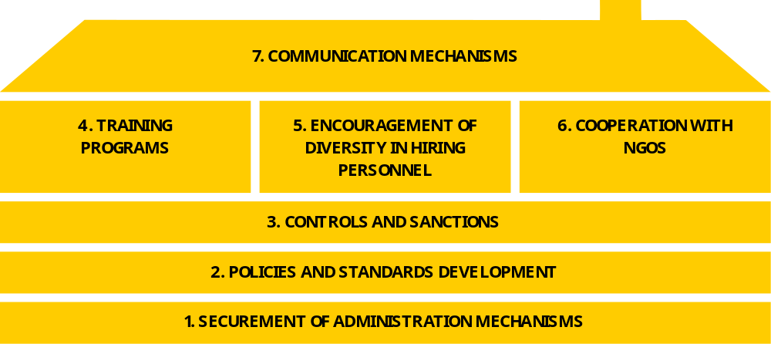

Slide 13
Thank you for your attention!
Trainer’s name

